Slide 1

Wireless Network
PMIT-
By-
Dr. Jesmin Akhter
Professor
Institute of Information Technology
Jahangirnagar University

Slide 2
Lecture 12 Mobile Cellular Network

Slide 3
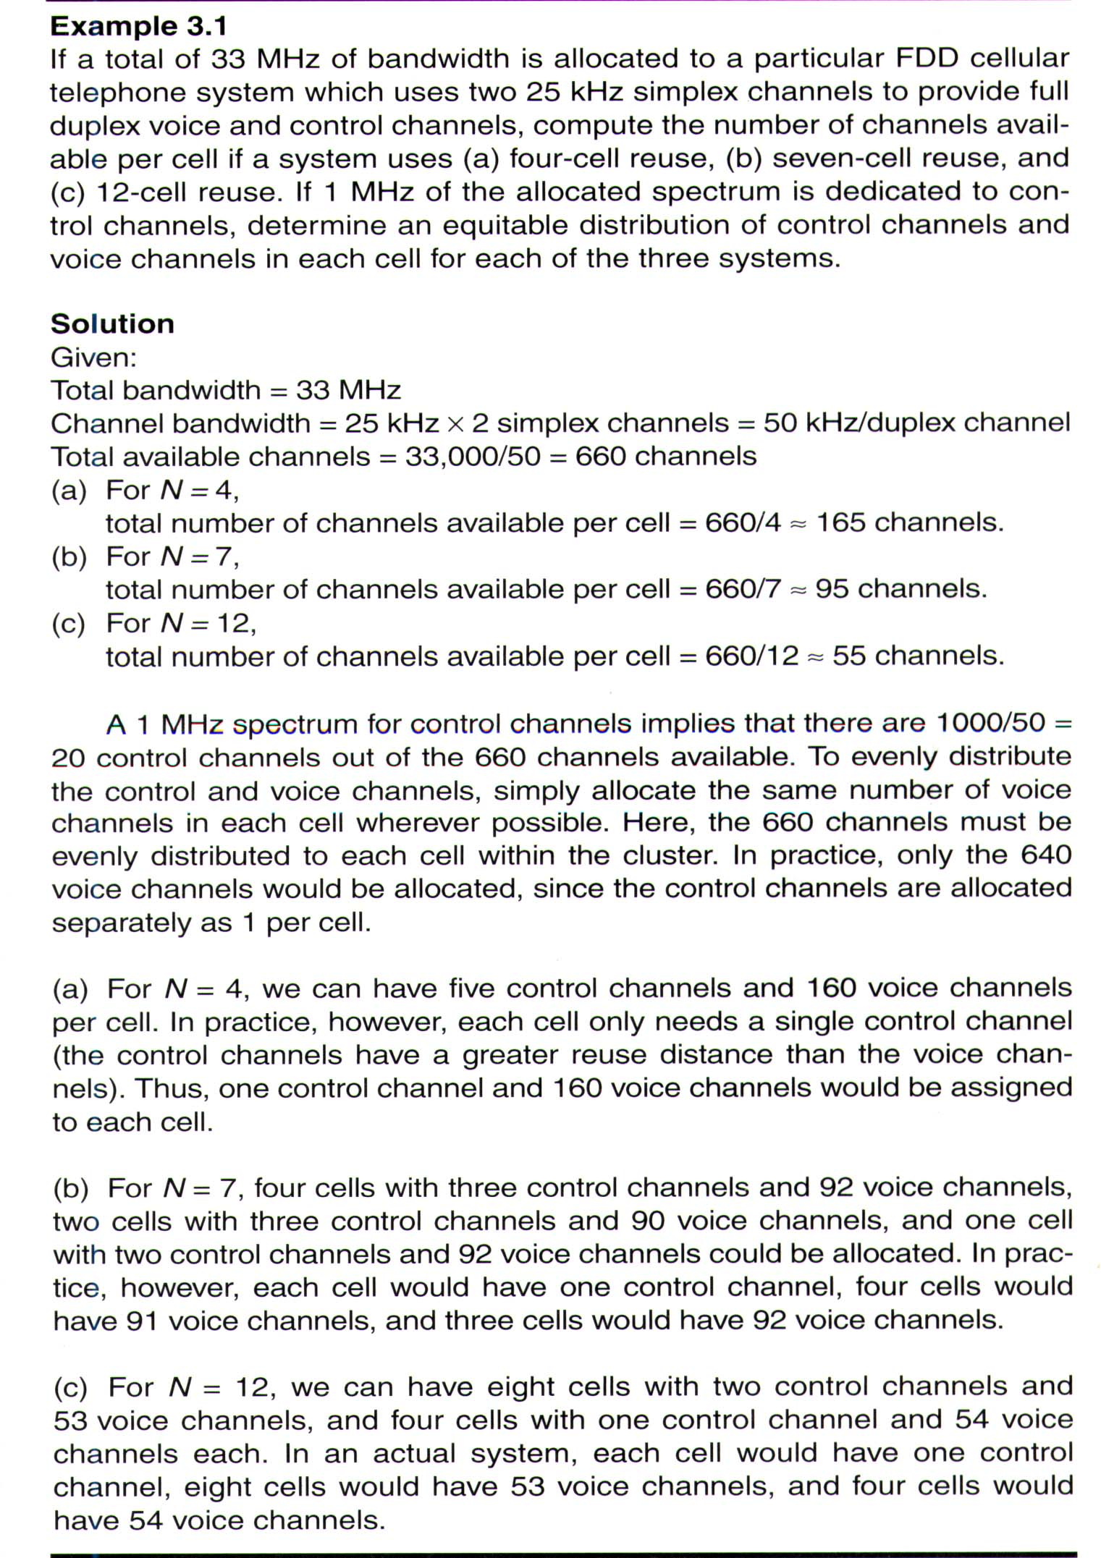
2.1 (Rappaport)

Slide 4
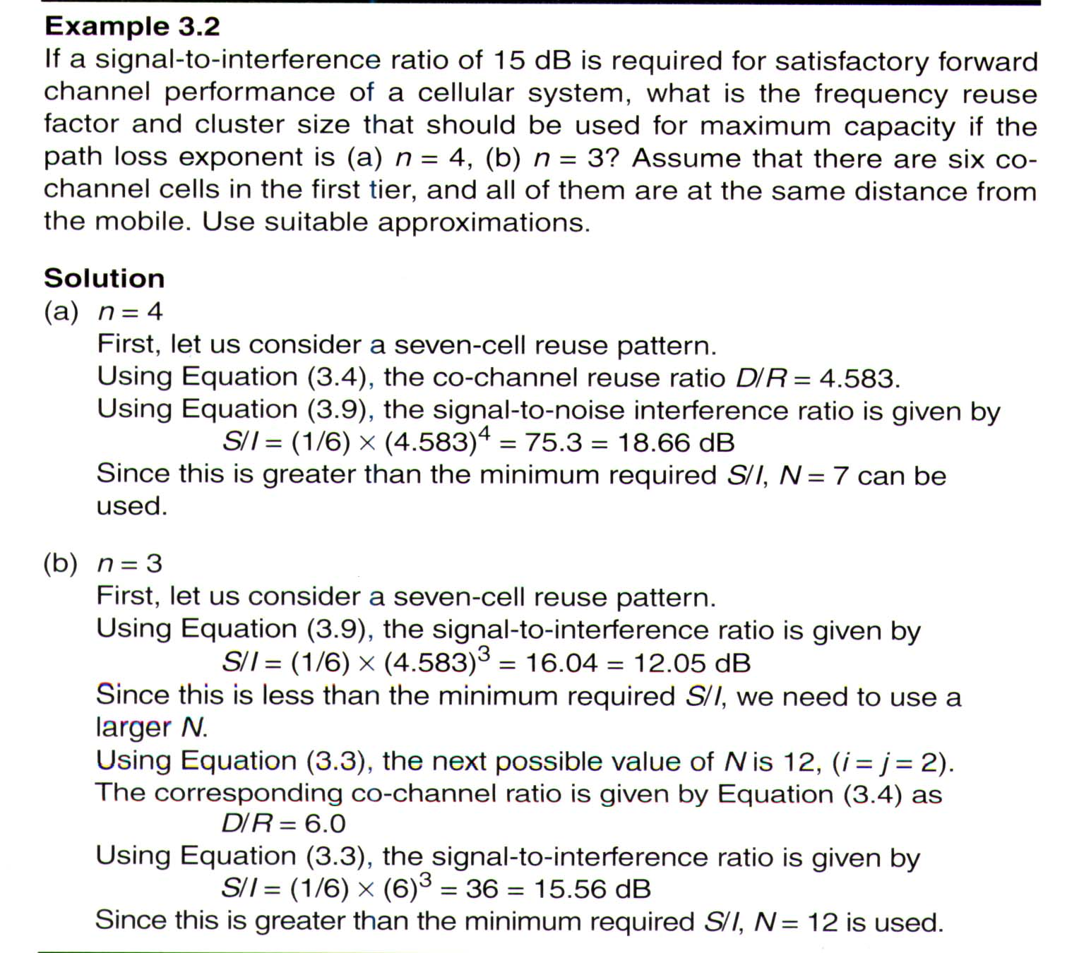
2.2 (Rappaport)

Slide 5
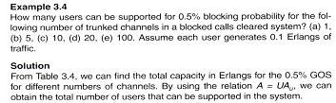
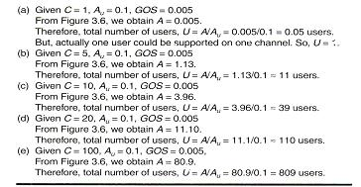
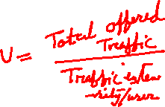
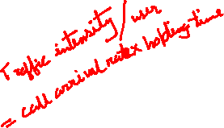
2.4 (Rappaport)

Slide 6
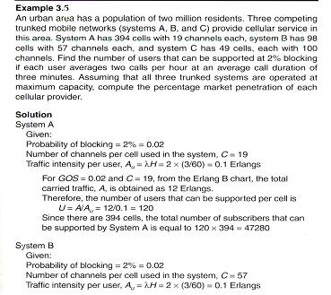
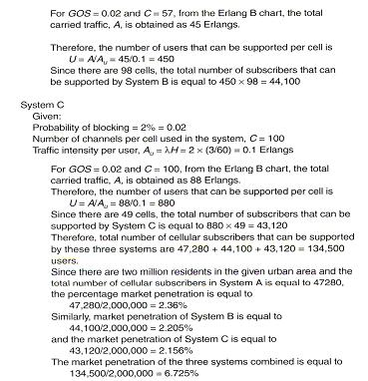
2.5 (Rappaport)

Slide 7
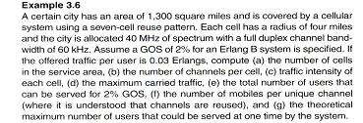
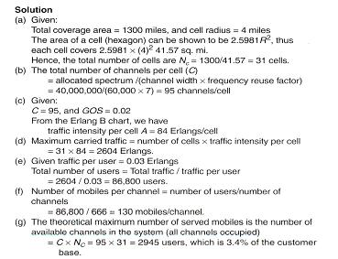
2.6 (Rappaport)
Notes:
3.Root of 3/2

Slide 8

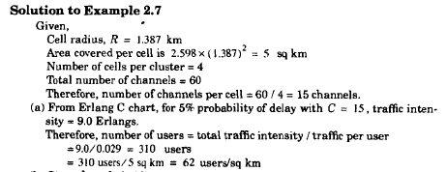
Notes:
(3 X Root 3)%2

Slide 9
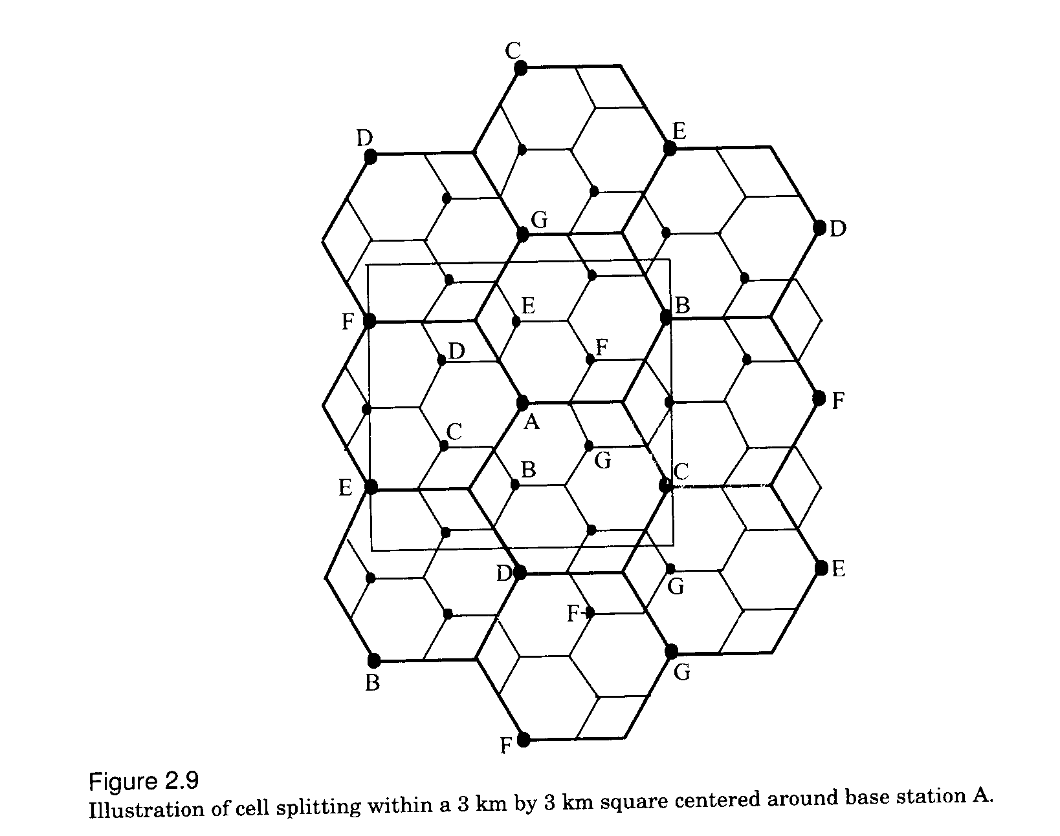
Fig 3.9

Slide 10
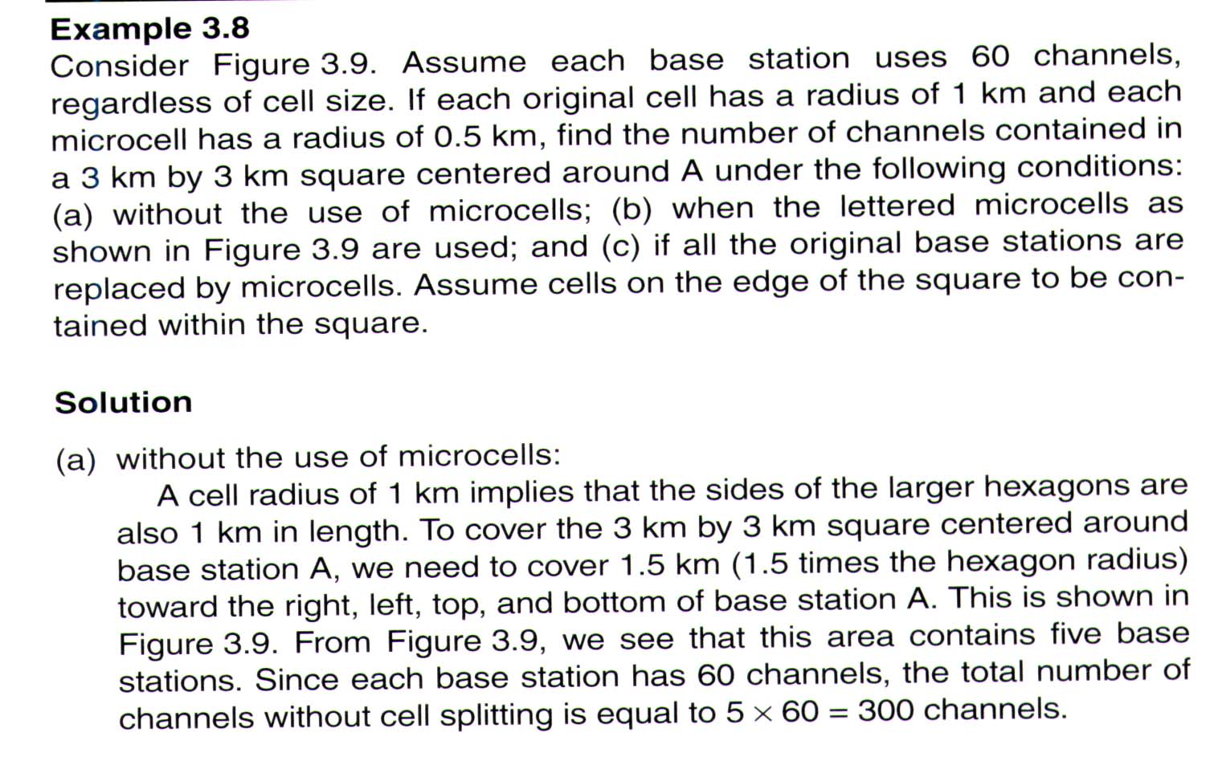
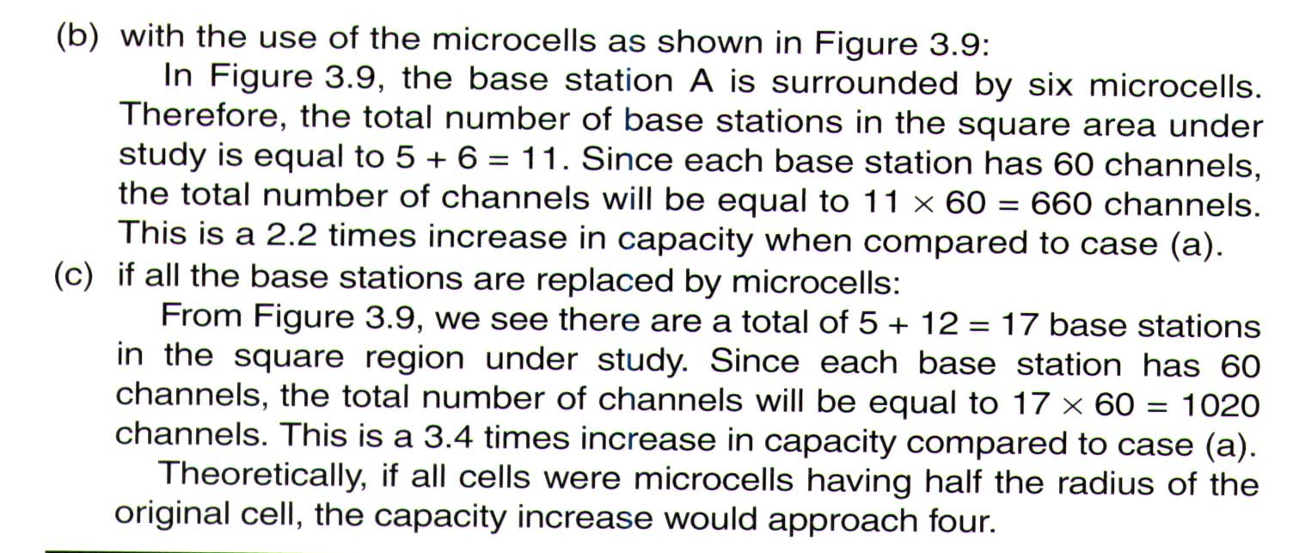
2.8 (Rappaport)

Slide 11
wireless communication
Goldsmith
Example-1
A city has total population of 5,00,000. A network planar found the behavior of users of the city like: they generate 2 calls/hour with average holding time of 1.5 minutes. The service provider got the license of BW that can support 27 carriers of GSM. Determine number of sectors of 3/9 cell pattern maintaining GoS of 5%.
Ans.
Traffic intensity/user = 2(1/60)1.5 = 0.05Erl
Carrier/sector = 27/9 = 3 carriers
Traffic channels/sector = 3*8-3 = 21
Where one TS out of 8TS is considered as control chanel.
From Erlang’s table,
For n = 21 and B = 5%, offered traffic A=16.189Erl
Number of users/sector = 16.189/0.05 = 324
Number of sectors = 5,00,000/324 =1544
Number of 3-sectored cell = 1544/3 = 515
Number of cell pattern = 515/3 = 172 or 1544/9=172
Sector-1
Sector-2
Sector-3
Sector-2
Sector-1
Sector-2
Sector-1
Sector-3
Sector-3
Number of users/cell= 324*3=972
Number of cells(3-sectored)
= 5,00,000/972 =515
Notes:
GOS of 2% blocking.
This implies that the channel allocations for cell sites are designed so that 2 out of 100 calls will be blocked due to channel occupancy during the busiest hour.

Slide 12
N=7 cell pattern
In N=7 cell cluster of omni three frequency groups of table 2 or 3 is used per cell following the sequence (N, N+7,N+14) where N is the cell number. The channel isolation within a cell is 7×30KHz=210KHz. The channel isolation of adjacent cell is 30KHz between cell 1 and 2 and that of 1 and 3 is 60KHz etc.The separation between adjacent cell,
1.5R
4.33R
3
3,10,17
6
6,13,20
5
5,12,19
3
3,10,17
1
1,8,15
6
6,13,20
5
5,12,19
4
4,11,18
7
7,14,21
1
1,8,15
2
2,9,16
4
4,11,18
7
7,14,21
3
3,10,17
2
2,9,16
dB
6
6,13,20
5
5,12,19
1
1,8,15
4
4,11,18
7
7,14,21
; taking number of co-channel interference j=6, propagation constant γ=4
2
2,9,16
Notes:
Root of 3+Root of 3+Root of 3%2

Slide 13
Sometimes cell cluster is formed arranging the cells in two rows like fig.2 having alternate channel assignments known as trapezoidal plan. Here the minimum separation between adjacent channel cells is 2×30=60KHz; better than the previous one.
dB
1
1,8,15
5
5,12,19
2
2,9,16
6
6,13,20
≈8R
1.5R
3
3,10,17
7
7,14,21
4
4,11,18
1
1,8,15
5
5,12,19
2
2,9,16
6
6,13,20
1
1,8,15
5
5,12,19
2
2,9,16
6
6,13,20
3
3,10,17
7
7,14,21
4
4,11,18
3
3,10,17
7
7,14,21
4
4,11,18
1
1,8,15
5
5,12,19
2
2,9,16
6
6,13,20
3
3,10,17
7
7,14,21
4
4,11,18
≈8.1R
Notes:
Root of 3+Root of 3+Root of 3+Root of 3%2

Slide 14
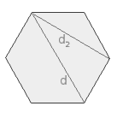
d = 2 * a d₂ = √3 * a
Where a is radius

Slide 15
Thank You

Slide 16
